Slide 1
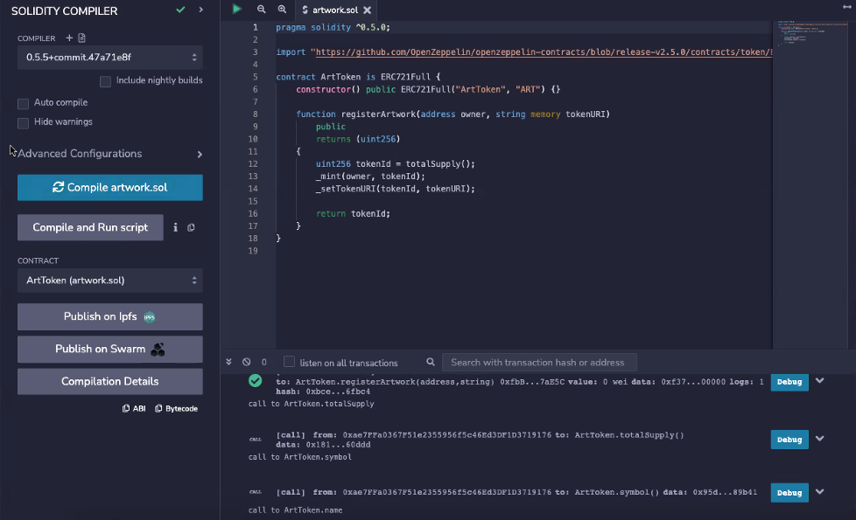

Slide 2
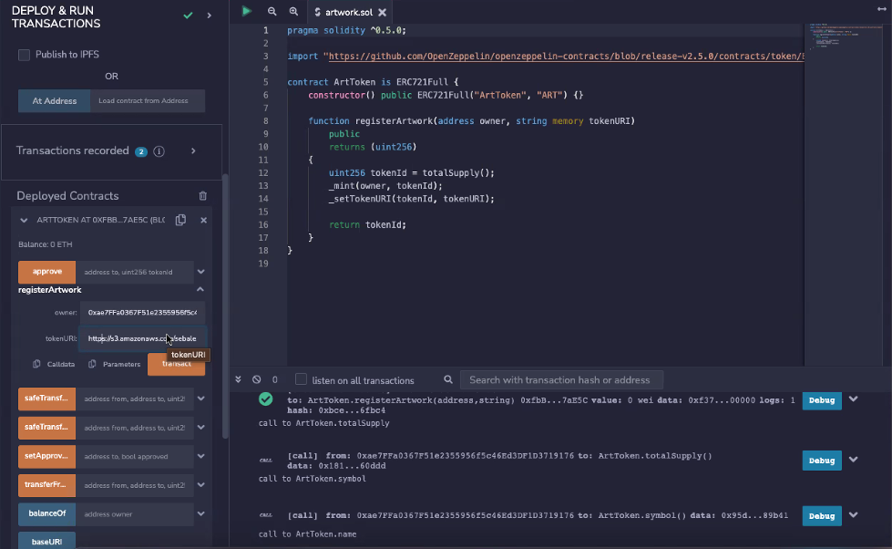

Slide 3
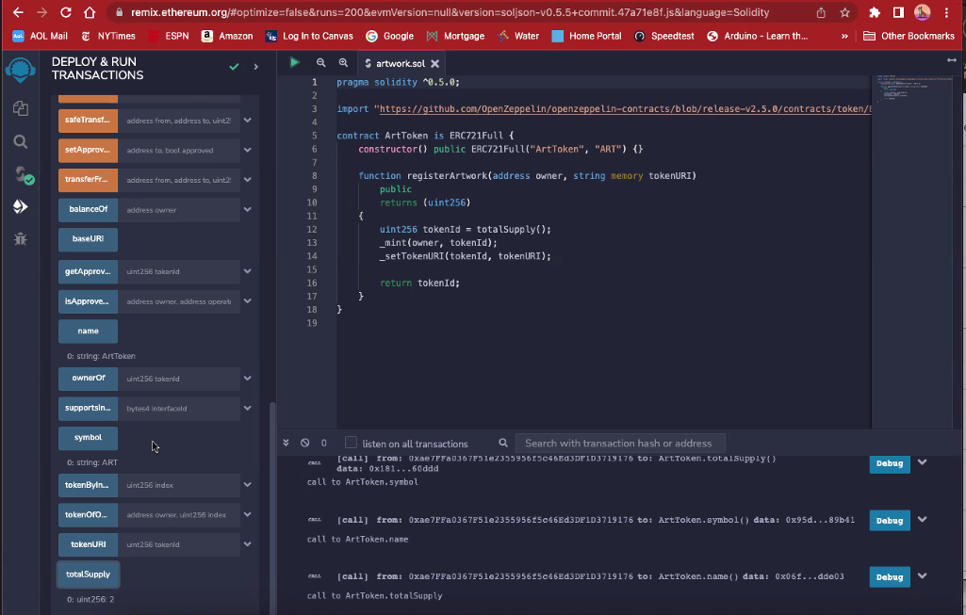

Slide 4
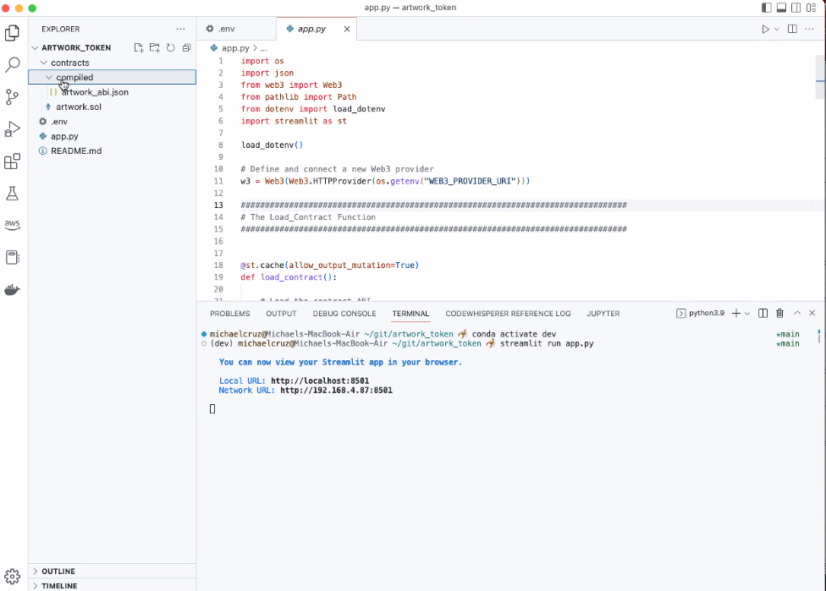

Slide 5
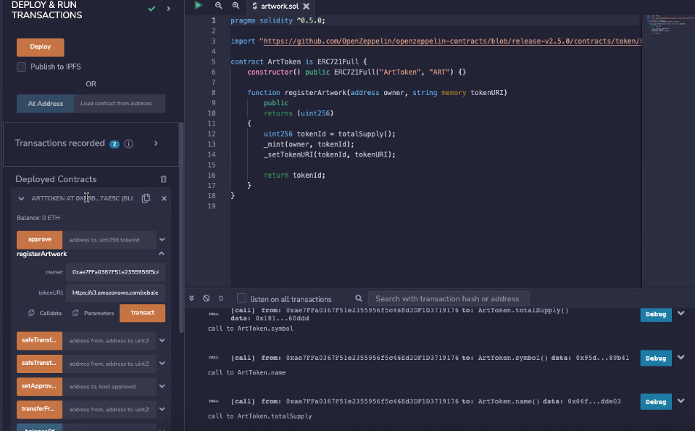

Slide 6
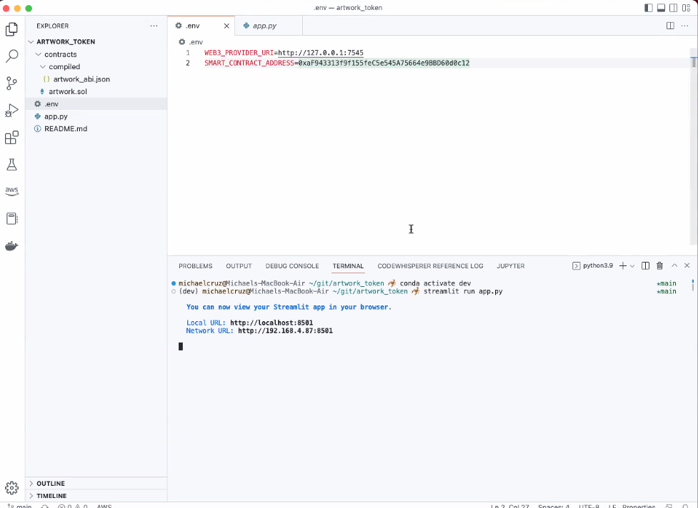

Slide 7
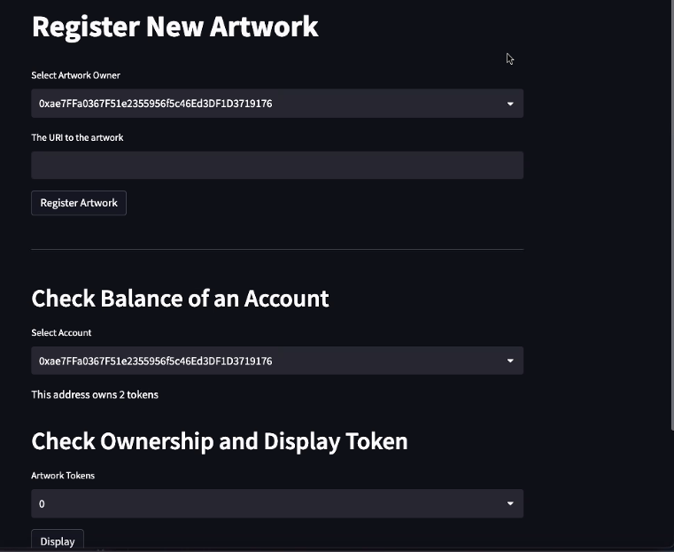

Slide 8
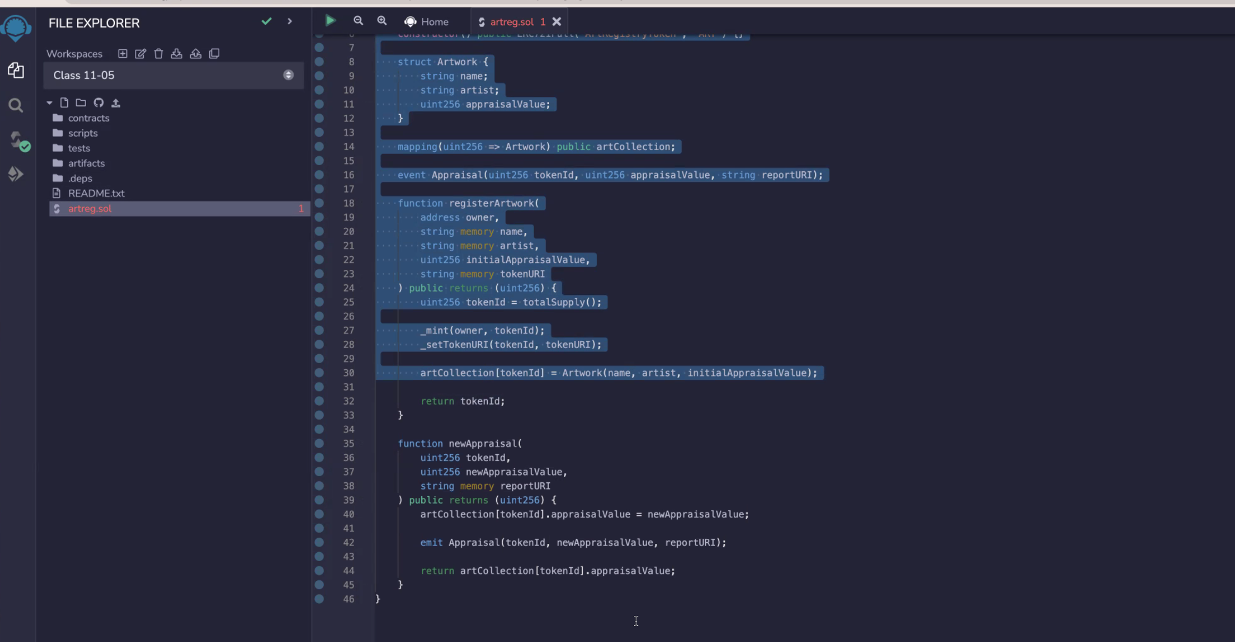
22-Activity 1

Slide 9
Step 1: Deploy the Contract
Deploy the awardCertificate token by using the Remix IDE, MetaMask, and Ganache.
Copy the SAMPLE.env file to a file named .env, and then update the file with the address of your deployed contract.
Copy the contract's ABI file into a JSON file.
Step 2: Load the Contract
In the app.py file, in the "Contract Helper function" section, complete the following steps:
Load the certificate token's compiled ABI JSON file.
Use the dotenv library to set the contract's address by loading the value from the .env file.
Connect to the contract by using Web3.py.
Step 3: Complete the “Award Certificate” Section
In the app.py file, in the "Award Certificate" section, complete the following steps:
Add the Streamlit component that’s needed for entering the address of the certificate recipient.
Add the Streamlit component that’s needed for entering either a link or a string of text for a certificate.
Hint You can generate a fake certificate by using a free online service and then link to this certificate. Or, you can accept a string of text, like "FinTech Certificate of Completion".
Use the Web3.py contract.functions object to perform a transaction on the awardCertificate contract function.
Step 4: Complete the “Display Certificate” Section
In the app.py file, in the "Display Certificate" section, complete the following steps:
Use the Web3.py contract.functions object and certificate_id to get ownerOf for the certificate.
Use the Web3.py contract.functions object and certificate_id to get tokenURI for the certificate.
Solidity: REMIX…..Copy ABI into .JSON File [Backend]
Solidity into Python

Slide 10
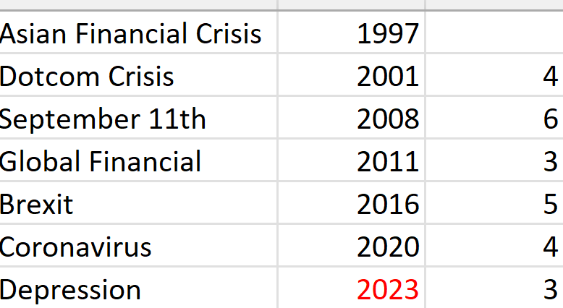
NFT
Token
(Hedge against market fluctuations)
Market Trending Lower
Black Swan Event
Other Market Draggers
API
Python Code (DOW, SPX, ETFs)
Market Data Reads
AWS
JSON/ABI
BlockChain (Transaction)
REMIX-
Smart Contract
(Increase Value of Coin as Market Drops
-Option To Buy or Sell)
Solidity Code

